Slide 1
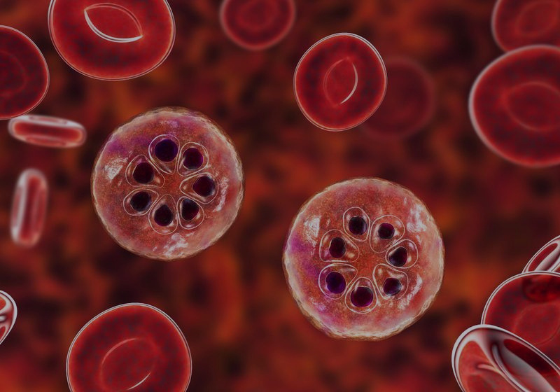
Malaria Detection Using Deep Learning (CNN)

Slide 2
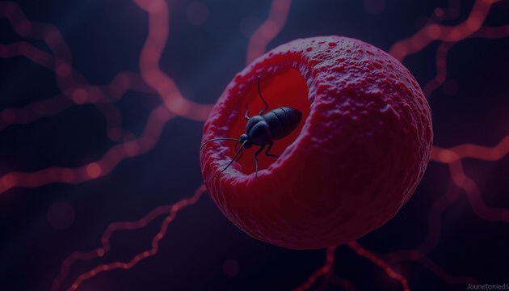
INTRODUCTION
Malaria is a life-threatening disease caused by parasites.
Early and accurate detection is crucial for effective treatment.
Manual diagnosis under a microscope is time-consuming and prone to errors.
AI and Deep Learning can assist in faster and more accurate diagnosis.

Slide 3
PROBLEM STATEMENT
Detecting whether a blood cell is Parasitized (Infected) or Uninfected (Healthy).
Manual inspection requires skilled pathologists and takes time.
Automate the detection process using Convolutional Neural Networks (CNNs).

Slide 4
PROJECT OBJECTIVES
Build a CNN model to classify blood cell images.
Use image preprocessing and augmentation for better generalization.
Achieve high accuracy in differentiating infected vs. healthy cells.
Provide a tool that can support medical professionals in diagnosis.

Slide 5
DATASET
Malaria Cell Images Dataset (Parasitized vs. Uninfected).
Total images: ~27,000 cell images.
Two categories:
Parasitized (Infected)
Uninfected (Healthy)
Split into training (80%) and testing (20%) sets.

Slide 6
DATA PREPROCESSING
Image resizing (150 × 150 pixels).
Normalization (scaling pixel values to [0,1]).
Data augmentation (rotation, zoom, flips) for diversity.
Ensures the model does not overfit and generalizes well.

Slide 7
MODEL ARCHITECTURE (CNN)
The CNN model takes blood cell images of size 150 × 150 × 3 as input.
First, it uses convolution and pooling layers to automatically extract important features from the images.
These features are then flattened and passed through dense layers, which help the model learn patterns for classification.
Finally, the output layer with sigmoid activation decides whether the cell is Parasitized (Infected) or Uninfected (Healthy).

Slide 8
MODEL TRAINING & RESULTS
Training was carried out for 10 epochs, with validation checks to monitor performance.
The model achieved a high test accuracy of around 95%, showing that it can correctly classify unseen blood cell images.
Both training and validation accuracy improved steadily, demonstrating the model’s strong potential for real-world medical applications.

Slide 9
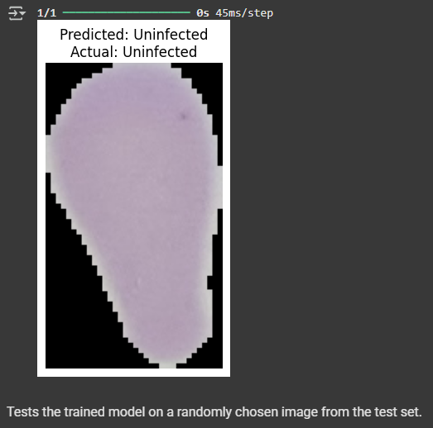
PREDITION EXAMPLES
Model tested on random images.
Correctly predicted labels:
Parasitized (Infected)
Uninfected (Healthy)

Slide 10
USE CASE IN HEALTHCARE
Fast, automated malaria detection in labs and rural clinics.
Reduces dependency on highly trained specialists.
Can be integrated with mobile health apps for remote diagnosis.
Supports doctors in making quicker and more reliable decisions.

Slide 11
CONCLUSION
The developed CNN model effectively detects malaria-infected cells with high accuracy.
This project highlights how Artificial Intelligence can enhance accuracy, speed, and accessibility in medical diagnosis.
Overall, it demonstrates the potential of deep learning applications in healthcare to support faster and more reliable disease detection.

Slide 12


